Slide 1


NoSQL Data Management
Department of Computer Science Engineering
School of Engineering

Slide 2
Experiments on MongoDB
Environmental Setup
Schema-less Collections
Application of Aggregates
Data Modeling in MongoDB
Replication SetUp
Sharding
Map-Reduce with MongoDB
Document Database Use cases

Slide 3
Understanding NoSQL and MongoDB
At the core of most large-scale web applications and services is a high-performance data storage solution.
The backend data store is responsible for storing everything from user account information to shopping cart items to blog and comment data.
Good web applications must store and retrieve data with accuracy, speed, and reliability.
Therefore, the data storage mechanism you choose must perform at a level that satisfies user demand.
The three most common are direct file system storage in
files,
Relational databases,
and NoSQL databases.

Slide 4
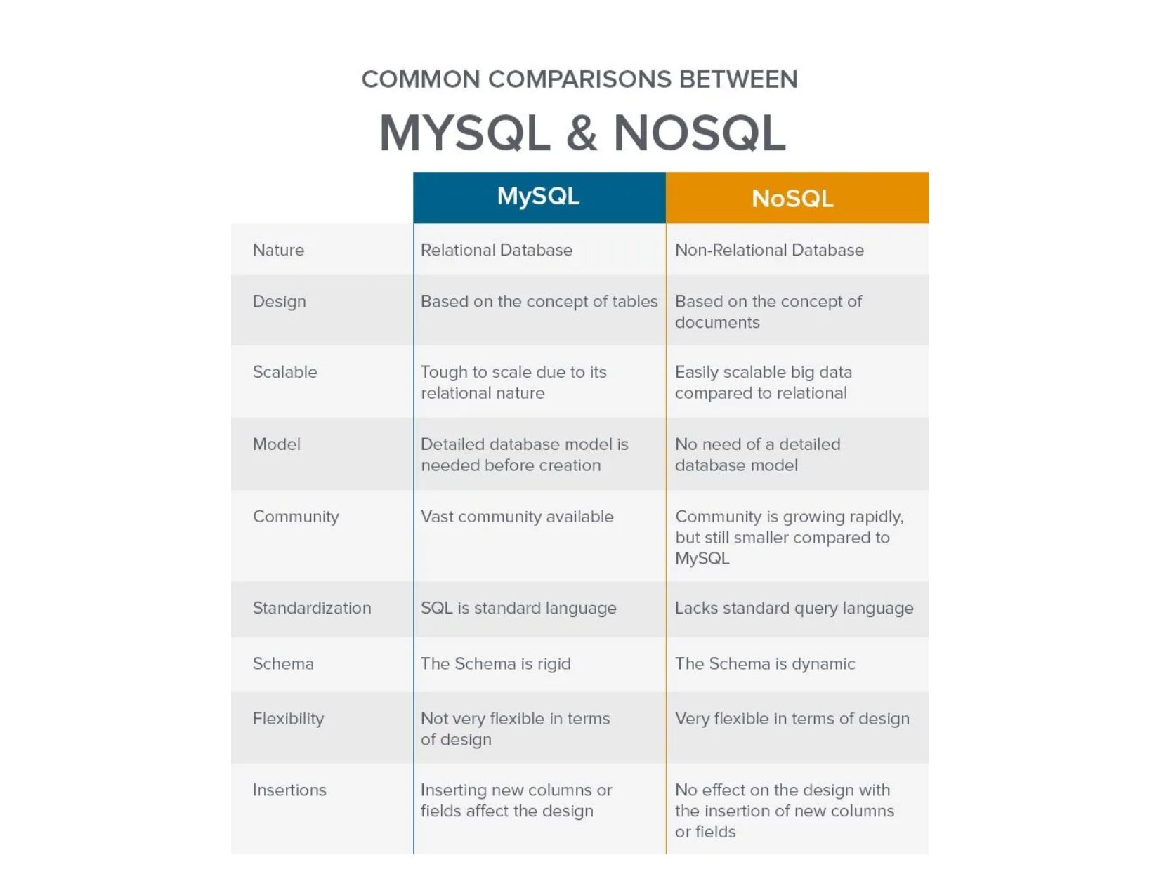

Slide 5








NoSQL
Key-value
Graph database
Document-oriented
Column family
Notes:
Huge quantity of data => Distributed systems => expensive joins =>
New fields, new demands (graphs) =>
Different data strucutres:
Simplier or more specific

Slide 6
Understanding MongoDB
MongoDB is a NoSQL database based on a document model where data objects are stored as separate documents inside a collection.
The motivation of the MongoDB language is to implement a data store that provides high performance, high availability, and automatic scaling.
1.Understanding Collections
MongoDB groups data together through collections.
A collection is simply a grouping of documents that have the same or a similar purpose.
A collection acts similarly to a table in a traditional SQL database, with one major difference. In MongoDB, a collection is not enforced by a strict schema; instead, documents in a collection can have a slightly different structure from one another as needed.
This reduces the need to break items in a document into several different tables, which is often done in SQL implementations.

Slide 7
Understanding MongoDB
2.Understanding Documents
A document is a representation of a single entity of data in the MongoDB database.
A collection is made up of one or more related objects.
A major difference between MongoDB and SQL is that documents are different from rows.
Row data is flat, meaning there is one column for each value in the row.
In MongoDB, documents can contain embedded subdocuments, thus providing a much closer inherent data model to your applications.
In fact, the records in MongoDB that represent documents are stored as BSON, which is a lightweight binary form of JSON, with field:value pairs corresponding to JavaScript property:value pairs.
These field:value pairs define the values stored in the document.
That means little translation is necessary to convert MongoDB records back into the JavaScript object that you use in your Node.js applications.

Slide 8
Understanding MongoDB
For example, a document in MongoDB may be structured similarly to the following with name, version, languages, admin, and paths fields:
{
name: "New Project",
version: 1,
languages: ["JavaScript", "HTML", "CSS"],
admin: {name: "Brad", password: "****"},
paths: {temp: "/tmp", project: "/opt/project", html: "/opt/project/html"}
}
Notice that the document structure contains fields/properties that are strings, integers, arrays,
and objects, just like a JavaScript object.

Slide 9
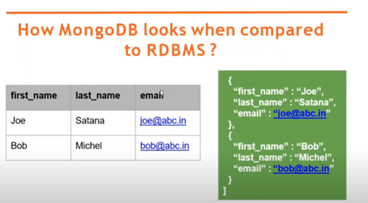
Understanding MongoDB

Slide 10
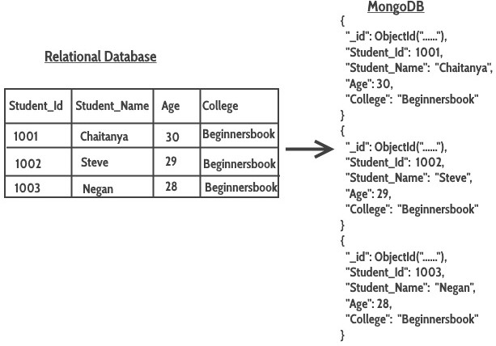
Understanding MongoDB

Slide 11
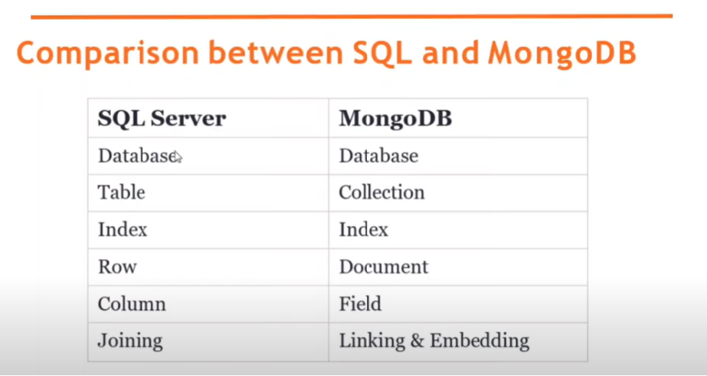
Understanding MongoDB

Slide 12
Document store
RDBMS |  | MongoDB
Database |  | Database
Table, View |  | Collection
Row |  | Document (JSON, BSON)
Column |  | Field
Index |  | Index
Join |  | Embedded Document
Foreign Key |  | Reference
Partition |  | Shard
Notes:
Javascript

Slide 13
Document store
RDBMS |  | MongoDB
Database |  | Database
Table, View |  | Collection
Row |  | Document (JSON, BSON)
Column |  | Field
Index |  | Index
Join |  | Embedded Document
Foreign Key |  | Reference
Partition |  | Shard
> db.user.findOne({age:39})
{
"_id" : ObjectId("5114e0bd42…"),
"first" : "John",
"last" : "Doe",
"age" : 39,
"interests" : [
"Reading",
"Mountain Biking ]
"favorites": {
"color": "Blue",
"sport": "Soccer"}
}
Notes:
Flexible schema
Javascript

Slide 14
CRUD
Create
db.collection.insert( <document> )
db.collection.save( <document> )
db.collection.update( <query>, <update>, { upsert: true } )
Read
db.collection.find( <query>, <projection> )
db.collection.findOne( <query>, <projection> )
Update
db.collection.update( <query>, <update>, <options> )
Delete
db.collection.remove( <query>, <justOne> )
Notes:
Create
The field name _id is reserved for use as a primary key; its value must be unique in the collection, is immutable, and may be of any type other than an array.
The field names cannot start with the $ character.
The field names cannot contain the . character.
Create with save
If the <document> argument does not contain the _id field or contains an _id field with a value not in the collection, the save() method performs an insert of the document.
Otherwise, the save() method performs an update.
sds

Slide 15
CRUD example
> db.user.insert({
first: "John",
last : "Doe",
age: 39
})
> db.user.find ()
{
"_id" : ObjectId("51…"),
"first" : "John",
"last" : "Doe",
"age" : 39
}
> db.user.update(
{"_id" : ObjectId("51…")},
{
$set: {
age: 40,
salary: 7000}
}
)
> db.user.remove({
"first": /^J/
})

Slide 16
Features
Document-Oriented storege
Full Index Support
Replication & High Availability
Auto-Sharding
Querying
Fast In-Place Updates
Map/Reduce
Agile
Scalable

Slide 17
Other features
Easy to install and use
Detailed documentation
Various APIs
JavaScript, Python, Ruby, Perl, Java, Java, Scala, C#, C++, Haskell, Erlang
Community
Open source

Slide 18
Understanding MongoDB
Applications:
Content Management Systems (CMS)
E-commerce Applications
Real-time Analytics
Social Media Platforms
Mobile Applications
Internet of Things (IoT)
Gaming Applications
Healthcare Applications
Financial Services

Slide 19
MongoDB Data Types
The BSON data format provides several different types that are used when storing the JavaScript objects to binary form.
It is important to understand these types because you can actually query MongoDB to find objects that have a specific property that has a value of a certain type.
For example, you can look for documents in a database whose timestamp value is a String object or query for ones whose timestamp is a Date object.
MongoDB assigns each of the data types an integer ID number from 1 to 255 that is used when querying by type.

Slide 20
MongoDB data types and corresponding ID number
Type | Number
Double | 1
String | 2
Object | 3
Array | 4
Binary data | 5
Object id | 7
Boolean | 8
Date | 9
Null | 10
Regular Expression | 11
JavaScript | 13

Slide 21
MongoDB data types
When comparing values of different BSON types, MongoDB uses the following comparison order from lowest to highest:
1. Min Key (internal type)
2. Null
3. Numbers (32-bit integer, 64-bit integer, Double)
4. String
5. Object
6. Array
7. Binary Data
8. Object ID
9. Boolean
10. Date, Timestamp
11. Regular Expression
12. Max Key (internal type)

Slide 22
Planning Your Data Model
Before you begin implementing a MongoDB database, you need to understand the nature of the data being stored, how that data is going to get stored, and how it is going to be accessed.
Understanding these concepts allows you to make determinations ahead of time and to structure the data and your application for optimal performance.
Specifically, you should ask yourself the following questions:
What are the basic objects that my application will be using?
What is the relationship between the different object types: one-to-one, one-to-many, or many-to-many?
How often will new objects be added to the database?
How often will objects be deleted from the database?
How often will objects be changed?
How often will objects be accessed?
How will objects be accessed: by ID, property values, comparisons, and so on?
How will groups of object types be accessed: by common ID, common property value, and so on?

Slide 23
Planning Your Data Model
Normalizing Data with Document References
Denormalizing Data with Embedded Documents.
Using Capped Collections
Understanding Atomic Write Operations
Considering Document Growth
Identifying Indexing, Sharding, and Replication Opportunities
Deciding on Data Life Cycles

Slide 24
Building the MongoDB Environment
Installing MongoDB
The first step in getting MongoDB implemented into your Node.js environment is installing the MongoDB server.
There is a version of MongoDB for each of the major platforms, including Linux, Windows, Solaris, and OS X.
There is also an enterprise version available for the Red Hat, SuSE, Ubuntu, and Amazon Linux distributions.
Before continuing, go to the MongoDB website at http://docs.mongodb.org/manual/installation/. Follow the links and instructions to download and install MongoDB in your environment:
As part of the installation and setup process, perform the following steps:
1. Download and extract the MongoDB files.
2. Add the <mongo_install_location>/bin to your system path.
3. Create a data files directory: <mongo_data_location>/data/db.
4. Start MongoDB using the following command from the console prompt:
mongod –dbpath <mongo_data_location>/data/db

Slide 25
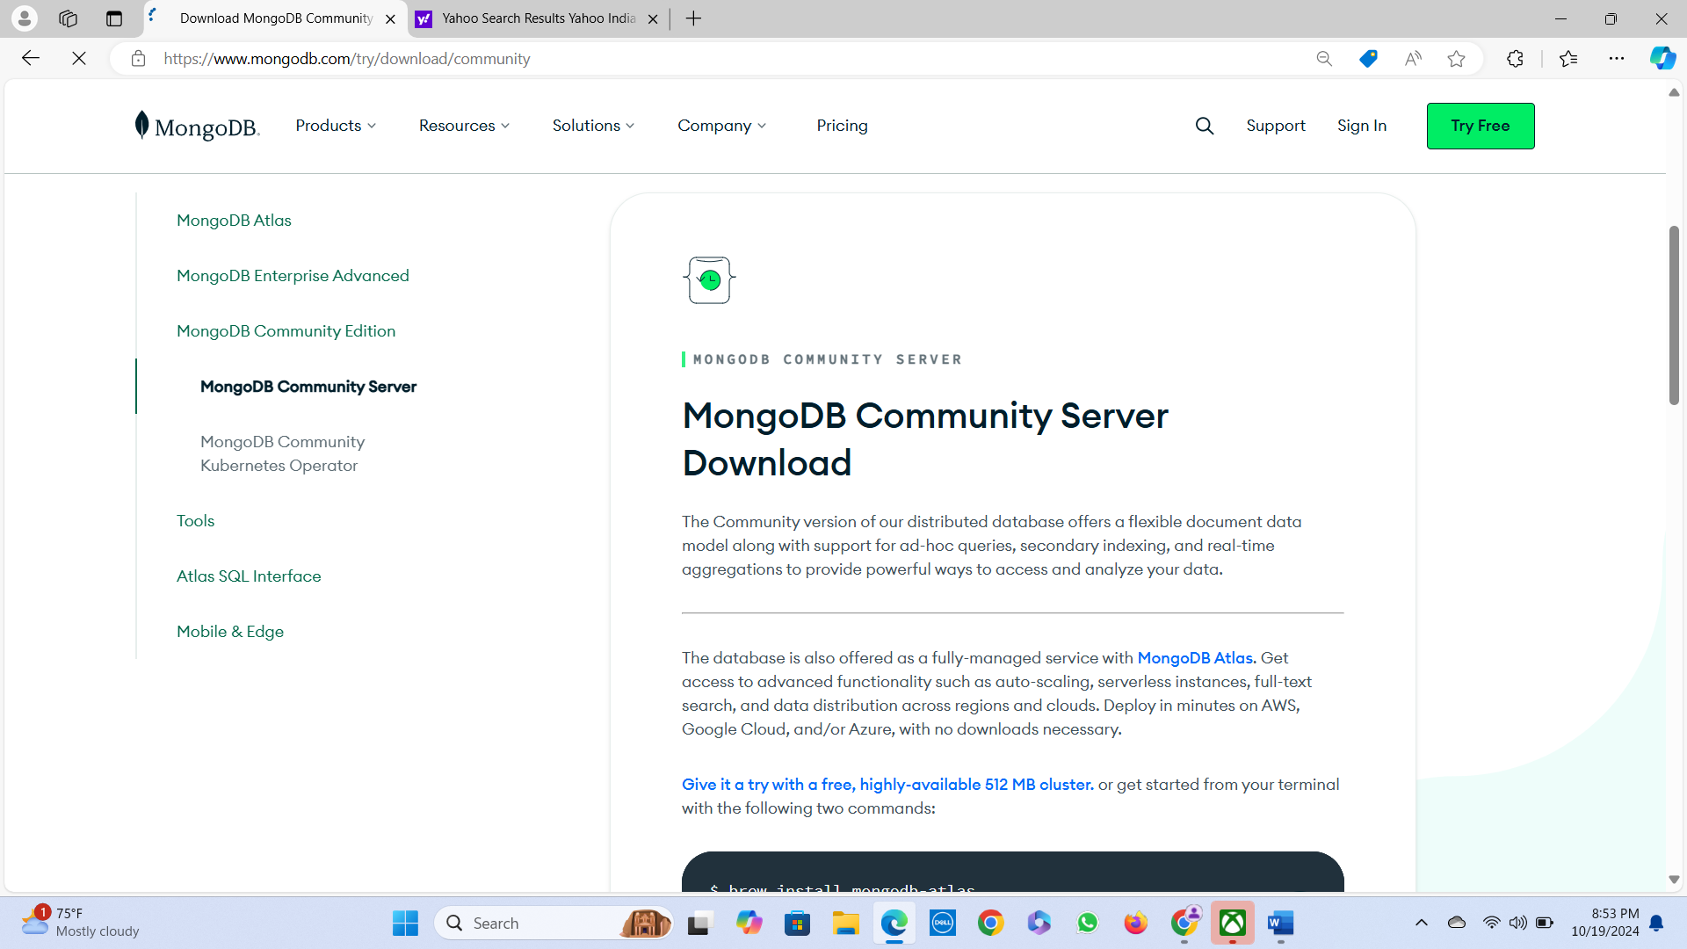
Installing MongoDB

Slide 26
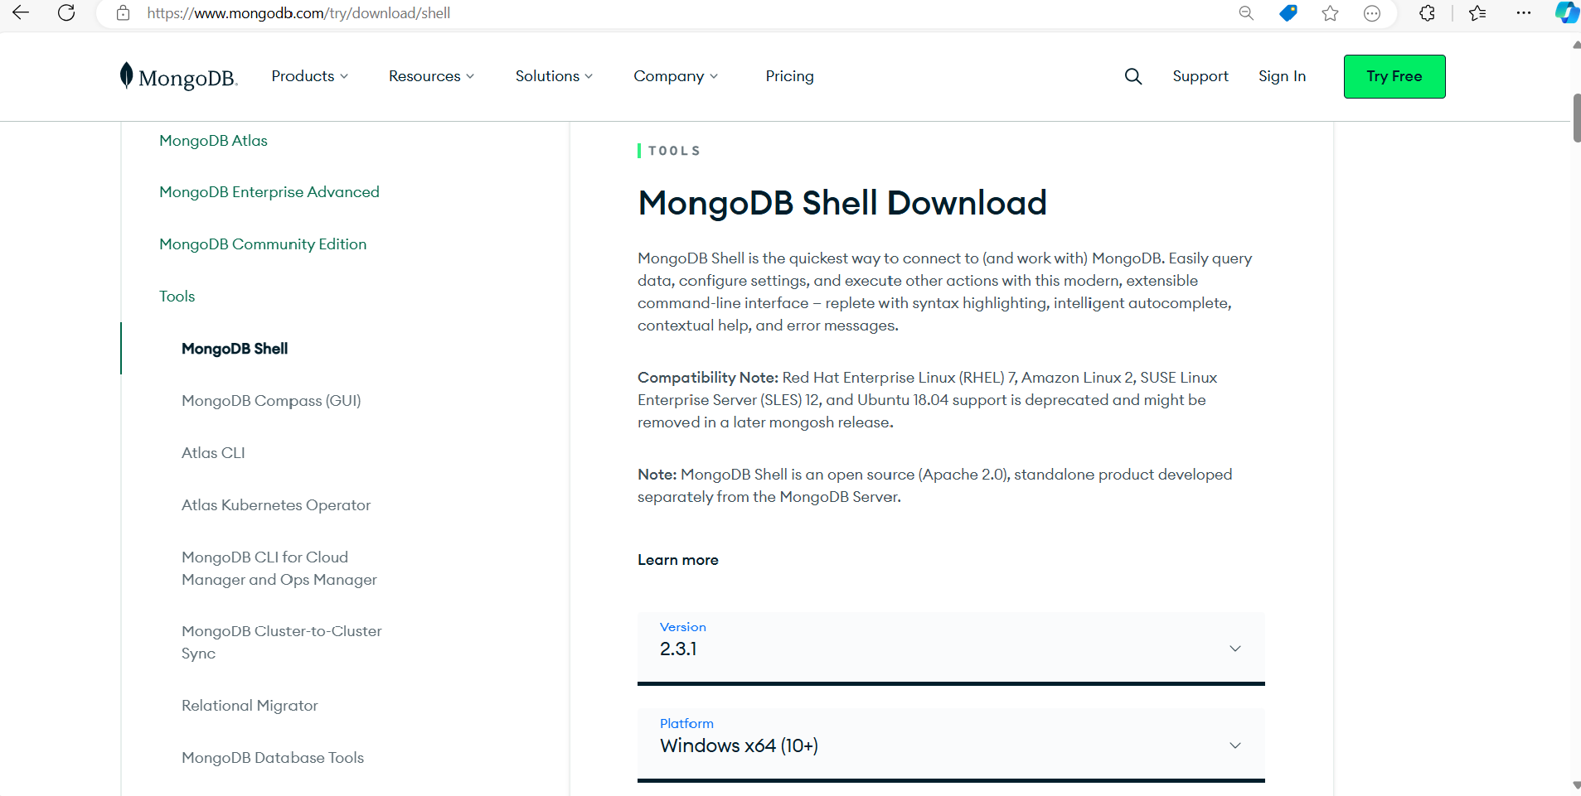
Installing MongoDB

Slide 27
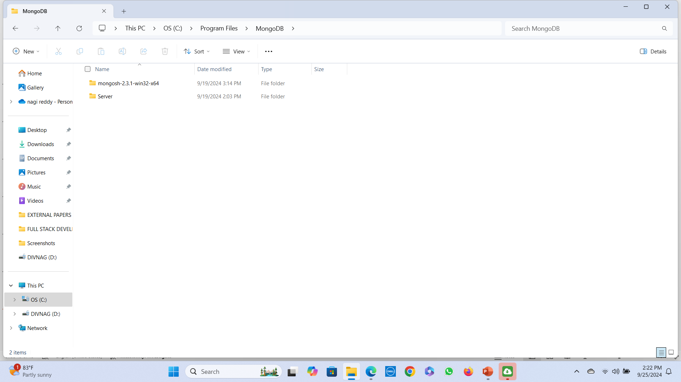
Installing MongoDB

Slide 28
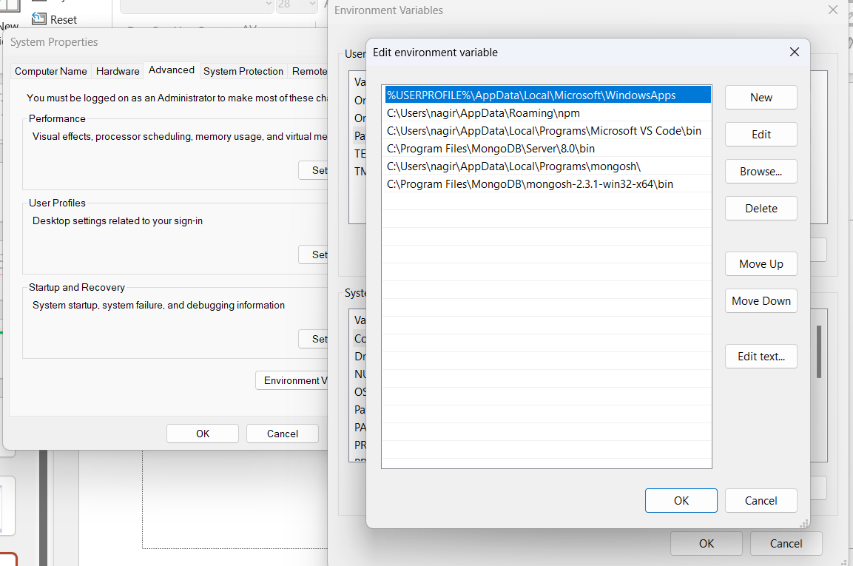
Installing MongoDB

Slide 29
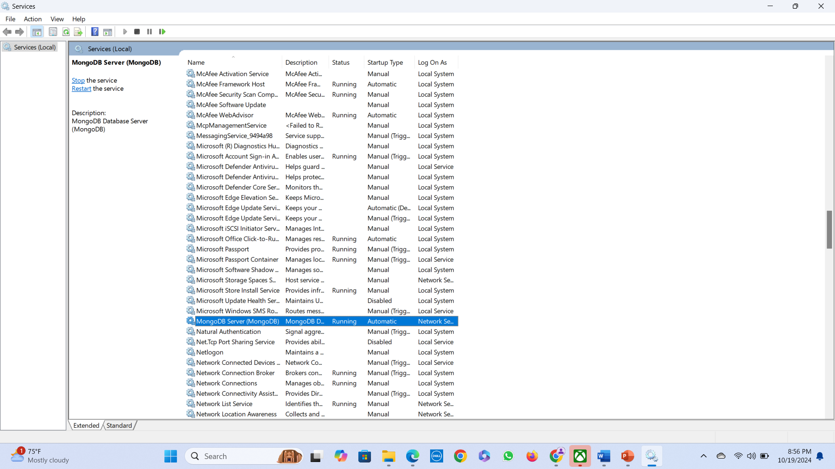
Installing MongoDB

Slide 30
Accessing MongoDB from the Shell Client/Mongosh
Once you have installed, configured, and started MongoDB, you can access it through the MongoDB shell.
The MongoDB shell is an interactive shell provided with MongoDB that allows you to access, configure, and administer MongoDB databases, users, and much more. You use the shell for everything from setting up user accounts to creating databases to querying the contents of the database.
To start the MongoDB shell, first make sure that mongod is running, and then run the mongod command, then execute the mongosh command from the console prompt.
Current Mongosh Log ID: 66f252c9808c7f3e6bc73bf7
Connecting to:
mongodb://127.0.0.1:27017/?directConnection=true&serverSelectionTimeoutMS=2000&appName=mongosh+2.3.1
Using MongoDB: 8.0.0
Using Mongosh: 2.3.1
For mongosh info see: https://www.mongodb.com/docs/mongodb-shell/
------
------
test>

Slide 31
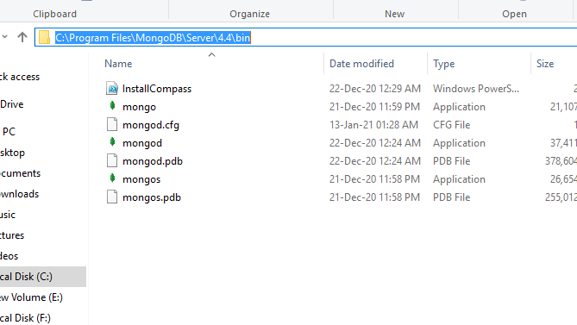
Accessing MongoDB from the Shell Client/ Cmd prompt
go to the location where MongoDB installed in step 5 in your system and copy the bin path:

Slide 32
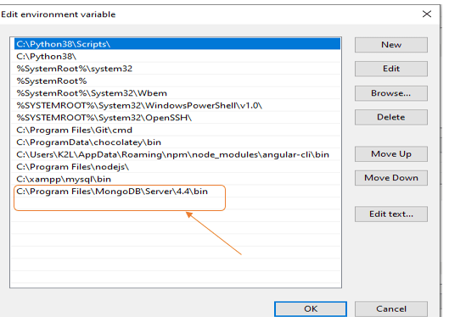
Accessing MongoDB from the Shell Client/ Cmd prompt
Now, to create an environment variable open system properties >> Environment Variable >> System variable >> path >> Edit Environment variable
paste the copied link to your environment system and click Ok:

Slide 33
Accessing MongoDB from the Shell Client/ Cmd prompt
Run MongoDB Server (mongosh)
Step 1. Start MongoDB Service After setting the environment variable, we will run the MongoDB server, i.e. mongosh. So, open the command prompt and run the following command: mongosh
When you run the above command, you will get error C:/data/db/ not found.
Step 2. Create required folders, goto C drive , create folder “data/db”.
Step 3. restart mongodb, and run the following command: mongosh
Step 4 : Create Database : use command
use databasename

Slide 34
Understanding MongoDB Shell commands
help <option>: Displays syntax help for MongoDB shell commands. The option argument allows you to specify an area where you want help.
■ use <database>: Changes the current database handle. Database operations are processed on the current database handle.
■ db.help: Displays help options for the database methods.
■ show <option>: Shows a list based on the option argument. The value of option can be:
■ dbs: Displays a list of databases.
■ collections: Displays a list of collections for the current database.
■ profile: Displays the five most recent system.profile entries taking more than 1 millisecond.
■ databases: Displays a list of all available databases.
■ roles: Displays a list of all roles for the current database, both built-in and userdefined.
■ users: Displays a list of all users for that database.
■ exit: Exits the database.

Slide 35
MongoDB Shell vs MongoDB Server:
MongoDB Server is responsible to store our data in database.
MongoDB Shell is responsible to manage Server.
By using this shell we can perform all required CRUD operations.
C --->Create
R --->Retrieve
U --->Update
D --->Delete

Slide 36
MongoDB Shell vs MongoDB Server:
MongoDB Server can be either local or remote (MongoDB ATLAS) .
To Launch/Start MongoDB Server --->mongod command
To Launch/Start MongoDB Shell --->mongosh Command
By default, MongoDB listens for connections from clients on port 27017 , and stores data in the /data/db directory.
To Check Server Version: mongod –version
To Check Shell Version: mongosh –version To Check Documentation: db.help()
To know current database: db.getName()

Slide 37
MongoDB
MongoDB Admin will use these default databases.
> show dbs
admin 0.000GB config 0.000GB local 0.000GB
1. admin:
admin database is used to store user authentication and authorization information .
2. config:
To store configuration information of mongodb server.
3. local:
local database can be used by admin while performing replication process.

Slide 38
Creation of Database and Collection
➢Database won't be created at the begining and it will be created dynamically.
➢Whenever we are creating collection or inserting document then database will be
created dynamically.
test> show dbs
admin 0.000GB
config 0.000GB
local 0.000GB
test> use MYDB1
switched to MYDB1
MYDB1> show dbs
admin 0.000GB
config 0.000GB
local 0.000GB

Slide 39
How to create collection
MYDB1> db.createCollection("students")
{ ok: 1 }
MYDB1> show dbs
MYDB1 8.00 KiB
admin 40.00 KiB
config 108.00 KiB
local 72.00 KiB

Slide 40
How to drop database?
db.dropDatabase() - current database will be deleted.
Note: db.getName() to know current database.
db.students.deleteOne({rollno:111})- to delete one document in a collection
{ acknowledged: true, deletedCount: 1 }

Slide 41
Basic CRUD Operations
C--->Create|Insert document
How to insert document into the collection?
db.students.insertOne({"rollno":501 , "name":"cse1"})- To insert single document.
db.collection.insertMany()- To insert multiple documents.
db.collection.insertMany([{..},{..},{..},{..}])
db.employees.insertMany([
{eno: 200, ename: "Sunny", esal: 1000, eaddr: "Mumbai"},
{eno: 300, ename: "Sunny", esal: 1000, eaddr: "Mumbai"}
])

Slide 42
Basic CRUD Operations
Creating Document separately and inserting into collection
var emp = {};
emp.eno = 7777;
emp.ename = "Bunny";
emp.esal = 777777;
emp.eaddr = "Hyderabad";
db.employees.insertOne(emp)
db.employees.insertMany([emp])
//db.employees.insert(emp)
//db.employees.insert([emp])

Slide 43
Basic CRUD Operations
Inserting Documents from java script file:
studentsdb --->database
students--->collection
students.js:
db.students.insertOne({name: “Karthick", rollno: 101, marks: 98 })
db.students.insertOne({name: "Ravi", rollno: 102, marks: 99 })
db.students.insertOne({name: "Shiva", rollno: 103, marks: 100 })
db.students.insertOne({name: "Pavan", rollno: 104, marks: 80 })
load("D:\students.js")
> show collections
> load("D:\students.js")
true
> show collections
students

Slide 44
Basic CRUD Operations
R--->Read / Retrieval Operation
db.collection.find() --->To get all documents present in the given collection.
db.collection.findOne() --->To get one document.
eg: db.employees.find()
> db.employees.find()
{ "_id" : ObjectId("5fe16d547789dad6d1278927"), "eno" : 100, "ename" : "Sunny", "esal" : 1000, "eaddr" : "Hyd" }
{ "_id" : ObjectId("5fe16da07789dad6d1278928"), "eno" : 200, "ename" : "Bunny", "esal" : 2000, "eaddr" : "Mumbai" }
{ "_id" : ObjectId("5fe16dc67789dad6d1278929"), "eno" : 300, "ename" : "Chinny", "esal" : 3000, "eaddr" : "Chennai" }
{ "_id" : ObjectId("5fe16ddb7789dad6d127892a"), "eno" : 400, "ename" : "Vinny", "esal" : 4000, "eaddr" : "Delhi" }
>db.employees.find().pretty()

Slide 45
Basic CRUD Operations
U-->Update Operation
db.collection.updateOne()
db.collection.updateMany()
db.collection.replaceOne()
➢If the field is available then old value will be replaced with new value.
➢If the field is not already available then it will be created.
➢The update operation document must contain atomic operators.
>db.employees.updateOne({ename: "Vinny"},{$set: {esal:10000}})
{ "acknowledged" : true, "matchedCount" : 1, "modifiedCount" : 1 }
Note: If anything prefixed with $ symbol, then it is predefined word in MongoDB

Slide 46
Basic CRUD Operations
D -->Delete
db.collection.deleteOne()
db.collection.deleteMany()
db.employees.deleteOne({ename:"Vinny"})

Slide 47
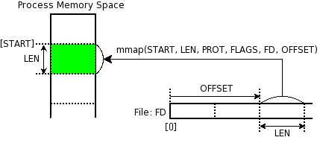
Memory Mapped Files
„A memory-mapped file is a segment of virtual memory which has been assigned a direct byte-for-byte correlation with some portion of a file or file-like resource.”¹
mmap()
¹: http://en.wikipedia.org/wiki/Memory-mapped_file
Notes:
http://docs.mongodb.org/manual/faq/storage/

Slide 48

Replica Sets
Host1:10000
Redundancy and Failover
Zero downtime for upgrades and maintaince
Master-slave replication
Strong Consistency
Delayed Consistency
Geospatial features
Host2:10001
Host3:10002
replica₁
Client
Notes:
DC – Data center

Slide 49
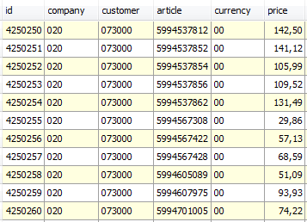
Sharding
Partition your data
Scale write throughput
Increase capacity
Auto-balancing
shard₁
shard₂
Host1:10000
Host2:10010
configdb
Host3:20000
Client
Host4:30000
Notes:
1970 – 2000: Vertical Scalability (scale-up)
Google, ~2000: Horizontal Scalability (scale-out)

Slide 50
Mixed
shard₁
...
Host1:10000
shard_{n}
Host2:10001
Host4:10010
Host3:10002
replica₁
configdb
Host5:20000
Client
Host6:30000
Host7:30000

Slide 51
Replication in MongoDB
Step 1: Create three directories needed for MongoDB replica set data storage.
mkdir \data\node1
mkdir \data\node2
mkdir \data\node3
Step 2: Start Three mongod Instances, Run in three separate terminals:
mongod --port 27017 --dbpath /data/node1 --replSet rs0
mongod --port 27018 --dbpath /data/node2 --replSet rs0
mongod --port 27019 --dbpath /data/node3 --replSet rs0
Step 3: Connect to mongo Shell and initiate Replica set:
Open a new terminal
Connect to primary node:-
mongosh --port 27017
Step 4: Execute the commands: below

Slide 52
Replication in MongoDB
Step 4: Execute the commands: below
Initiate the replica set:
rs.initiate(
{ _id: "rs0", members: [
{ _id: 0, host: "localhost:27017" },
{ _id: 1, host: "localhost:27018" },
{ _id: 2, host: "localhost:27019" } ] })
2. Check Replica Set Status
rs.status()
3. View Configuration of Replica Set
rs.conf()
4. Add a New Member (Optional for expansion)
rs.add("localhost:27020")
5. Remove a Member
rs.remove("localhost:27020")

Slide 53
Replication in MongoDB
Step 4: Execute the commands: below
6. Force Re-election of Primary
rs.stepDown()
Use this to force a secondary to become the primary
7. Check Which Node is Primary
db.isMaster()

Slide 54
MongoDB Aggregates
$match : filters documents based on a specified query.
Example :
db.orders.aggregate([{ $match: {status=“shipped”}}])
$group : groups documents by a specified key and performs aggregate operations like counting, summing, averaging.
$project : reshapes documents by including, excluding, adding or renaming fields.
$sort : sorts the documents in the pipeline based on specified fields.
$lookup : performs a left outer join between two collections, combining documents from both based on a specified condition.
$unwind : deconstruct an array field from input documents, outputting one document for each element in the array.
$addFields : adds new fields to documents.
$count : counts the number of documents in the aggregation pipeline.
$facet : processed multiple aggregation pipelines within a single stage on the same input documents.

Slide 55
MongoDB Qualifiers
Skip() : Skips a specified no. of documents before returning results.
limit() : Restricts the no. of documents returned by a query.
find() : Retrieves documents matching the specified query criteria.
findOne() : Retrieves a single document matching the specified query criteria.
sort() : Sorts the result of a query based on specified fields.
countDocuments() : Returns an accurate count of documents matching the filter.
distinct() : Retrieves unique values for a specified field.
project() : Specifies which fields to include or exclude from the query results.

Slide 56
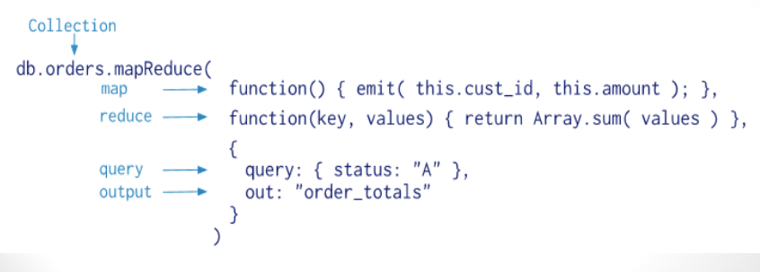
Map-Reduce with MongoDB
Map-reduce is a data processing paradigm for condensing large volumes of data into useful aggregated results. For mapreduce operations, MongoDB provides the mapReduce database command.
Consider the following map-reduce operation:
How mapping and reducing takes place for the result:

Slide 57
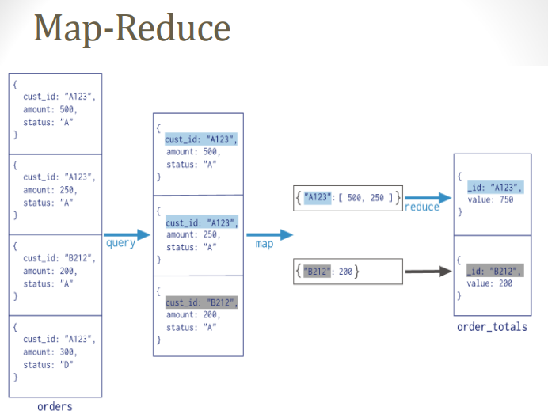
Map-Reduce with MongoDB
How mapping and reducing takes place for the result:
the mapReduce command takes 2 primary inputs, the mapper function and the reducer function.
A Mapper will start off by reading a collection of data and building a Map with only the required fields we wish to process and group them into one array based on the key.
And then this key value pair is fed into a Reducer, which will process the values.

Slide 58
Map-Reduce with MongoDB syntax
db.collection.mapReduce(
function() {emit(key, value);},
//Define map function
function(key,values) {return reduceFunction}, {
//Define reduce function
out: collection,
query: document,
sort: document,
limit: number
}
)

Slide 59
Map-Reduce with MongoDB syntax Explanation
• Map: – It is a JavaScript function. It is used to map a value with a key
and produces a key-value pair.
Reduce: – It is a JavaScript function. It is used to reduce or group together all the documents which have the same key.
Out: – It is used to specify the location of the map-reduce query output.
Query: – It is used to specify the optional selection criteria for selecting documents.
Sort: – It is used to specify the optional sort criteria.
Limit: – It is used to specify the optional maximum number of documents which are desired to be returned.

Slide 60
Map-Reduce with MongoDB syntax Explanation Example
> db.author.save({
"book_title" : "MongoDB Tutorial", "author_name" : "aparajita",
"status" : "active", "publish_year": "2016" })
> db.author.save({
"book_title" : "Software Testing Tutorial", "author_name" : "aparajita",
"status" : "active", "publish_year": "2015" })
> db.author.save({
"book_title" : "Node.js Tutorial", "author_name" : “Kritika",
"status" : "active", "publish_year": "2016" })
> db.author.save({
"book_title" : "PHP7 Tutorial", "author_name" : "aparajita",
"status" : “passive", "publish_year": "2016 })
> db.author.find()

Slide 61
Map-Reduce with MongoDB syntax Explanation Example
> db.author.mapReduce(
function() { emit(this.author_name,1) },
function(key, values) {return Array.sum(values)},
{ query:{status:"active"}, out:"author_total" } ).find()
• Out-Put
{ "_id" : "aparajita", "value" : 2 }
{ "_id" : " Kriti ", "value" : 1 }

Slide 62
Document Database (mongoDB) Use cases
A blog platform architecture utilizing MongoDB typically follows a multi-tiered approach, often implemented using a MERN (MongoDB, Express.js, React.js, Node.js) or similar stack.
1. Frontend (Client-side):
User Interface: Built with a JavaScript framework like React.js, Angular, or Vue.js, providing dynamic and interactive content.
Interaction: Handles user input for creating, editing, viewing, and deleting blog posts and comments.
API Communication: Communicates with the backend API to send and receive data.

Slide 63
Document Database (mongoDB) Use cases
2. Backend (Server-side):
Web Server:
Powered by Node.js and the Express.js framework (or similar like Koa.js, NestJS), responsible for handling incoming requests from the frontend.
Routing: Defines API endpoints for various operations ( e.g., /posts, /users, /comments)
Business Logic : Implement the core logic for managing blog posts, users, and comments, including validation, authentication, and authorization.
Database Interaction : Connects to MongoDB and performs CRUD operations on the data. Mongoose, an ODM (Object Data Modeling) library is commonly used to provide a structured and schema-based approach to interact with MongoDB.

Slide 64
Document Database (mongoDB) Use cases
3. Database (Data Storage):
MongoDB:
Collections : Data is organized into collections, such as:
1. posts (title, content, author, publication date, tags)
2. users (uname, email, password hashes, roles)
3. comments ( comment_text)
Document Structure : MongoDB’s document model allows for flexible schemas, enabling nested data structures within a single document (e.g., embedding comments directly within a post document if appropriate, or linking them via references)

Slide 65
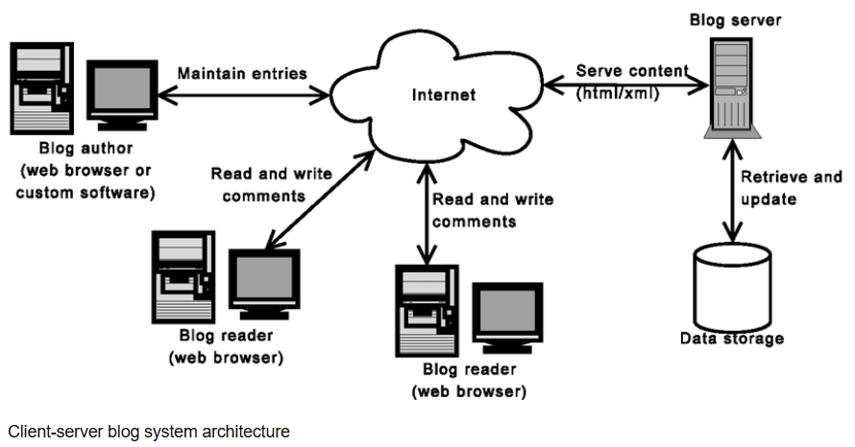
Document Database (mongoDB) Use cases : Blog Platform High level Architecture

Slide 66
Document Database (mongoDB) Use cases : Blog Platform low level (database) Architecture
User (NoSQL):
Unique identifier (Mobile/Email).
First/Last Name.
Post (NoSQL)
Post ID.
User ID.
Comment ID.
Media link (Stored in GCS/S3)
Comment (NoSQL):
Comment ID.
User ID.
Comment content.
Reply (NoSQL):
Reply ID.
Comment ID.
Reply content.
Connection (NoSQL):
User ID.
Followed User ID.
Like (NoSQL):
User ID.
Post ID.
Like count.

Slide 67
MONGO DB & NODE JS : Extra Topic
Install MongoDB Driver
Let us try to access a MongoDB database with Node.js.
To download and install the official MongoDB driver, open the Command Terminal and execute the following:
Download and install mongodb package:
>npm install mongodb
added 12 packages, and audited 30 packages in 2s
found 0 vulnerabilitiesdb
Connecting to MongoDB from Node.js
Node.js can use this module to manipulate MongoDB databases:
var mongo = require('mongodb');

Slide 68
MONGO DB & NODE JS
Implement CRUD operations on the given dataset using MongoDB.
C- CREATE
R- READ / RETRIVE
U- UPDATE
D- DELETE

Slide 69
// Connect to database and close the database connection
// Connect to database and close the database connection
const { MongoClient } = require('mongodb')
// Create Instance of MongoClient for mongodb
const client = new MongoClient('mongodb://localhost:27017')
// Connect to database
client.connect()
.then(() => {
console.log('Connected Successfully!')
//Close the database connection
console.log('Exiting..')
client.close()
})
.catch(error => console.log('Failed to connect!', error))

Slide 70
To insert one document
// to insert one document
const { MongoClient } = require('mongodb')
// Create Instance of MongoClient for mongodb
const client = new MongoClient('mongodb://localhost:27017')
// Insert to database
client.db('MYDB').collection('students').insertOne({
name: 'cse1',
email: 'cse1@example.com'
})
.then((res) => {
console.log(res)
client.close()
})
.catch((err) => console.log(err))

Slide 71
To find one document
//to find one document
const { MongoClient } = require('mongodb')
// Create Instance of MongoClient for mongodb
const client = new MongoClient('mongodb://localhost:27017')
// Insert to database
client.db('MYDB').collection('students')
.findOne({name:'cse1'})
.then((res) => {
console.log(res)
client.close()
})
.catch((err) => console.log(err))

Slide 72
To update one document
//to update one document
const { MongoClient } = require('mongodb')
// Create Instance of MongoClient for mongodb
const client = new MongoClient('mongodb://localhost:27017')
// Insert to database
client.db('MYDB').collection('students')
.updateOne({ name: 'cse1' },
{
$set:
{ email: 'cse123@example.com' }
})
.then((res) => {
console.log(res)
client.close()
})
.catch((err) => console.log(err))

Slide 73
To delete one document
//to delete one document
const { MongoClient } = require('mongodb')
// Create Instance of MongoClient for mongodb
const client = new MongoClient('mongodb://localhost:27017')
// Insert to database
client.db('MYDB').collection('students')
.deleteOne({ name: 'cse1' })
.then((res) => {
console.log(res)
client.close()
})
.catch((err) => console.log(err))

Slide 74


